Slide 1
Welcome & Opening Remarks
Brenda Berg
President & CEO, BEST NC

Slide 2
What is NC STRIDE?

Slide 3
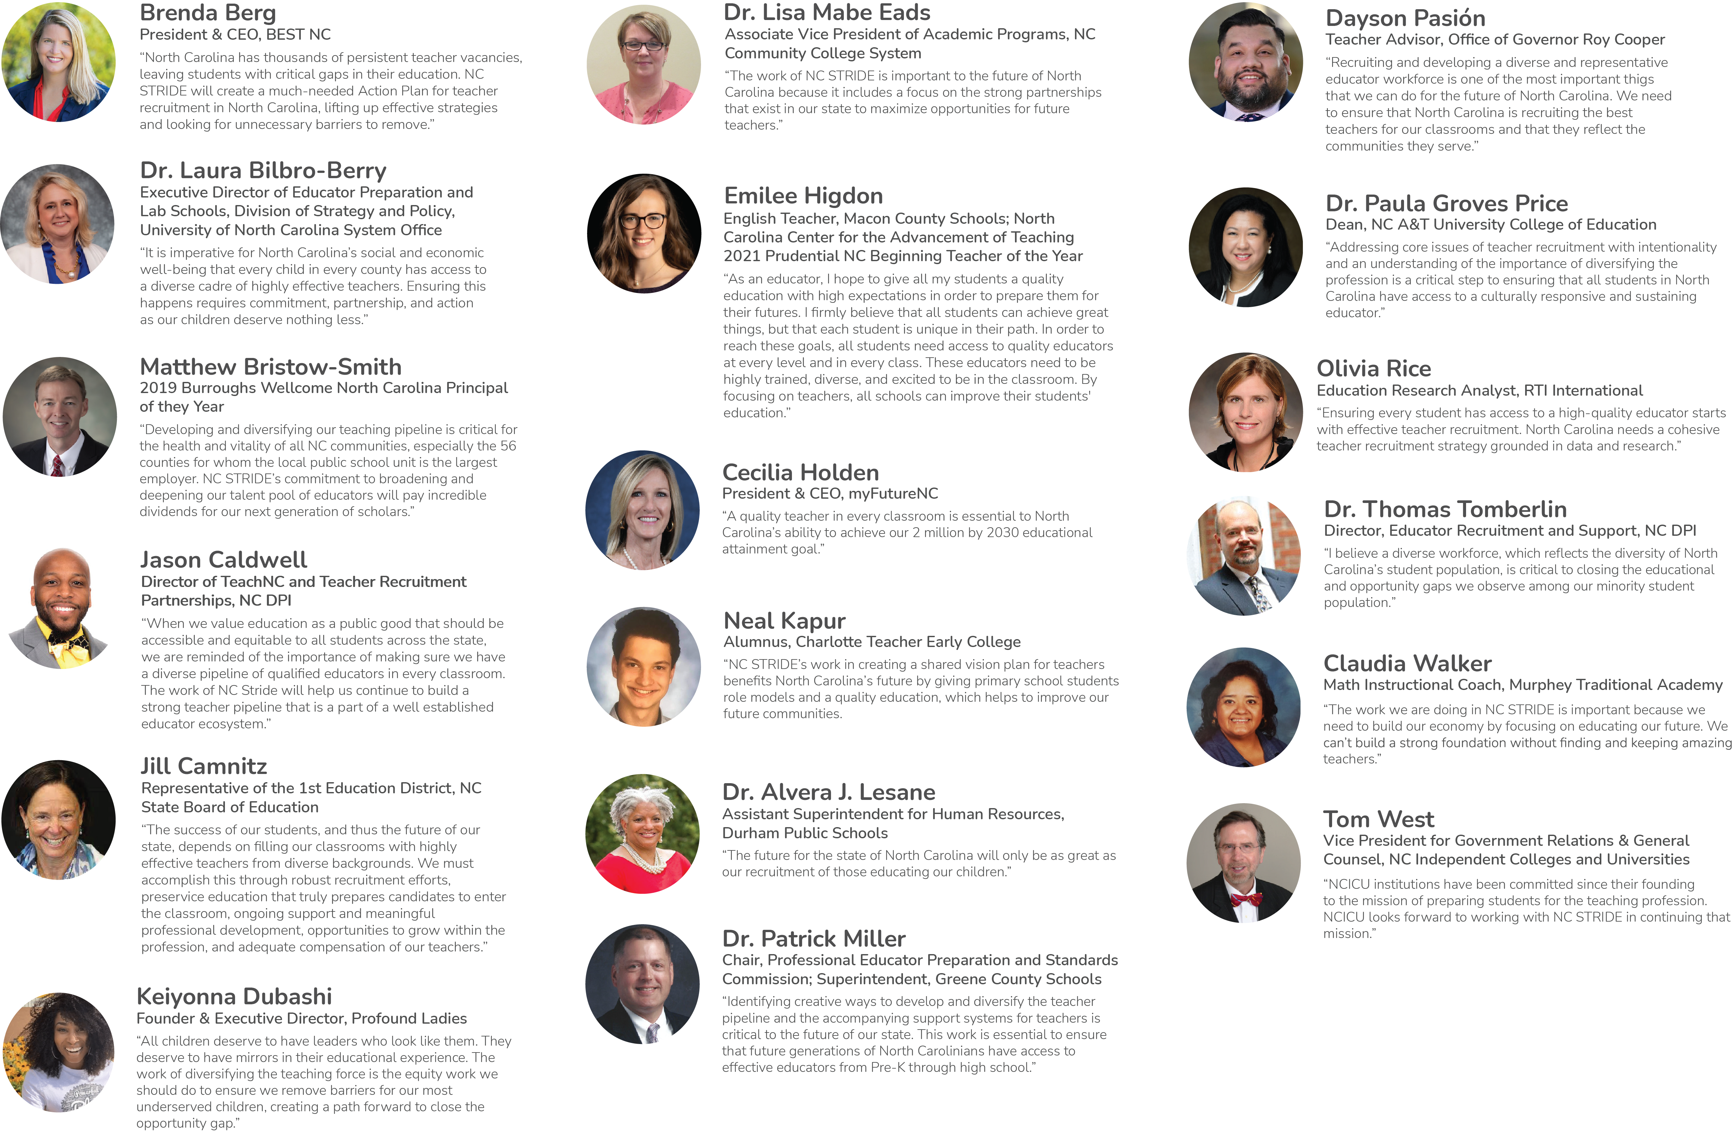
NC STRIDE Planning Team

Slide 4
Forward STRIDE: How We Got Here

Slide 5
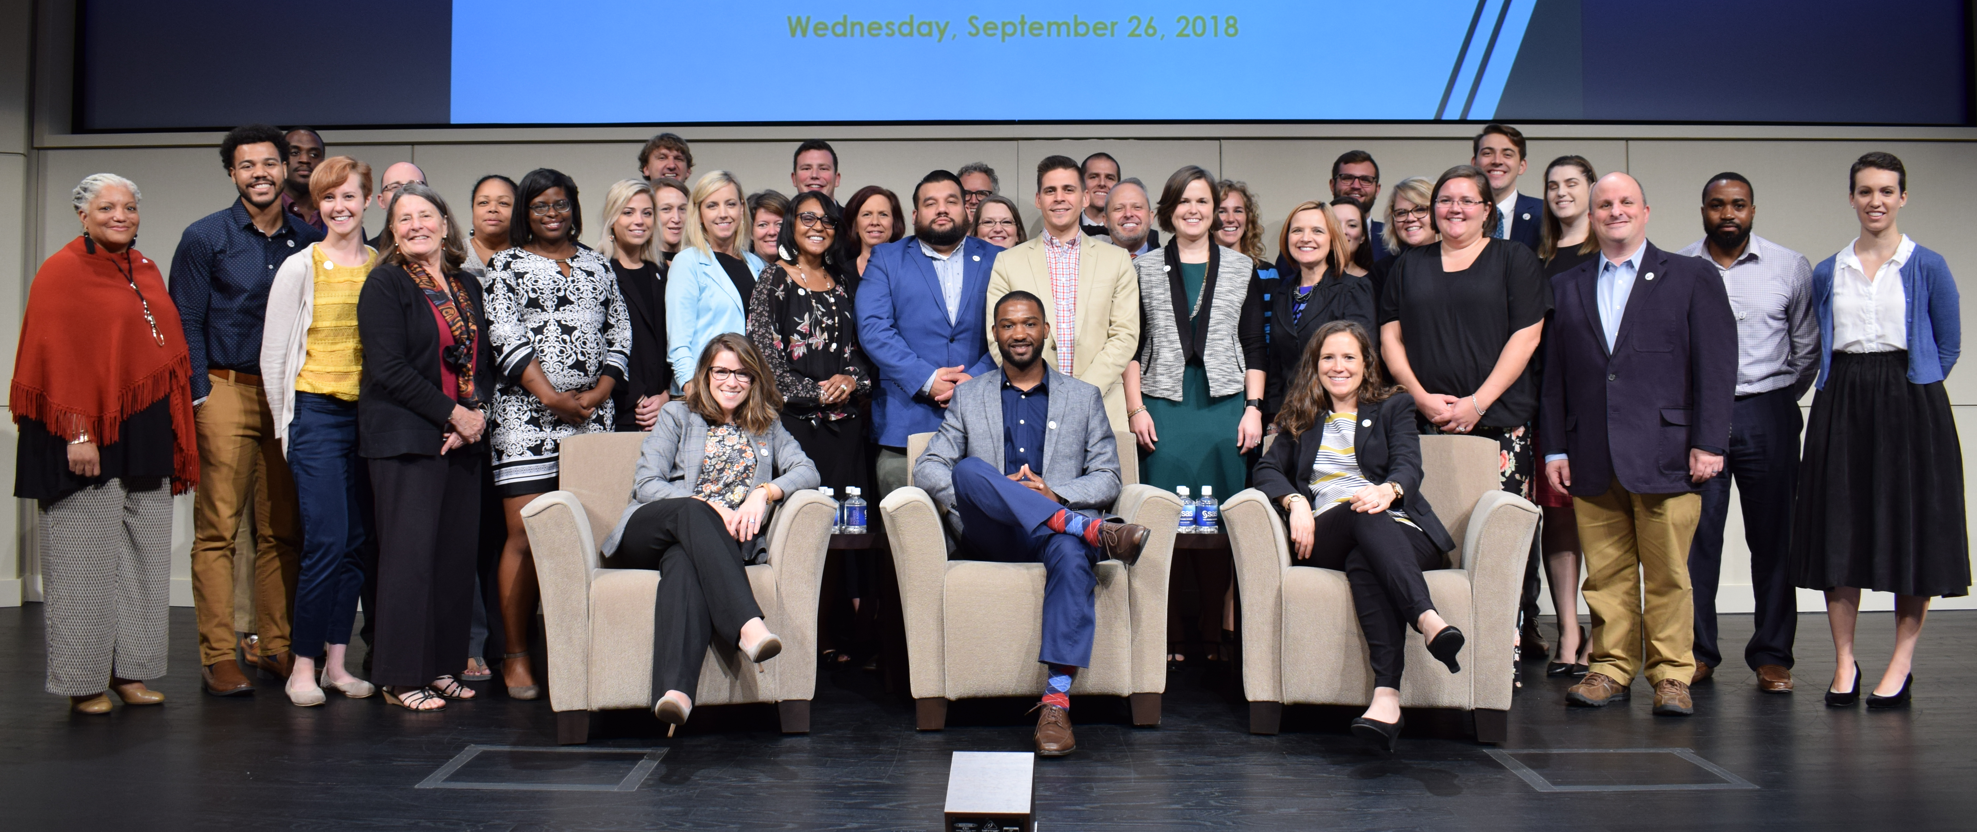
Converging Efforts
Emerging Issues Forum: Teachers & The Great Economic Debate (2014)
Excellence: North Carolina’s Education Vision (2015)
UNC BOG Subcommittee on Teacher & School Leader Quality (2015)
myFutureNC (2017)
Commission on Access to Sound Basic Education (2017)
UNC Strategic Plan (2017)
FIT Leaders Roadmap (2018)
NC State Board of Education Strategic Plan (2019)
DRIVE Taskforce (2019)
NC STRIDE (2020)
Operation Polaris (2021)
Hunt-Lee Commission (2022)
Notes:
myFutureNC
UNC Strategic Plan
UNC BOG Subcommittee
Commission on Access to Sound Basic Education | NC Gov. Cooper
First in Teaching FIT Roadmap – BEST NC
NC State Board of Education Approved Strategic Plan
DRIVE Task Force | NC Gov. Cooper
NC STRIDE – BEST NC
Operation Polaris | NC DPI
Hunt-Lee Commission (hunt-institute.org)
Also: Facts and Figures – BEST NC

Slide 6
Shared Values
Ensure every student has access to an effective educator
Expand teacher recruitment
Better support for all teachers, particularly beginning and residency
Great teachers want to work for great leaders
Shore up the leaky pipeline:
Licensure barriers
Traditional EPP graduates who don’t enter NC schools
High turnover pathways like residency
Notes:
A-Call-to-Action-Final-Report_040319.pdf (myfuturenc.org)
unc_strategic_plan.pdf (northcarolina.edu)
Microsoft Word - Commission_final recommendations_final (nc.gov)
First in Teaching FIT Roadmap – BEST NC
Approved_Strategic-Plan-Outline_08202019.pdf (asqnc.com)
DRIVE Task Force | NC Gov. Cooper
NC STRIDE – BEST NC
Operation Polaris | NC DPI

Slide 7
We Are Making Progress
In the last two years, EPP enrollment is up 40%.
TeachNC created as the first ever statewide recruitment initiative, collaborating with every EPP and LEA in the state to recruit teachers.
New data, including new vacancy data and a statewide jobs board.
Over 400 high-potential principal candidates have been recruited and prepared to work in high need schools.
Over 900 teachers are in new Advanced Teaching Roles in 19 districts.
Several districts are preparing to pilot teacher apprenticeships.
Teaching Fellows Program has expanded to three MSIs.
Teacher Supplement Assistance Allotment established ($170M).
Notes:
TeachNC: (over 2,000 recruited in the first two years)
ATR: Over 900 teachers are in advanced teacher roles, finally being paid to extend their reach to their colleagues and more students without leaving the classr

Slide 8
And Yet...
Every school year starts with teacher vacancies, particularly in high-need schools and key subject areas like STEM and Special Education.
Traditionally prepared teachers are our highest performing pipeline of teachers and yet 38% of EPP graduates do not enter a NC classroom, indicating that starting pay and support is perhaps not adequate.
Our fastest growing and most diverse pipeline of teachers also has the highest turnover rate and the lowest academic outcomes, creating a call to action for better educator support, particularly for residency teachers.
Effective teachers are sometimes forced to leave the profession because they have only one way to prove their effectiveness for licensure, even if they have solid growth data, performance evaluations, and student feedback.
Starting teacher pay is not competitive with surrounding states, teachers wait a decade or more to earn the full base pay for a fully licensed teacher, and fewer than 20 districts offer significant pay for taking advanced roles.
Notes:
TeachNC: (over 2,000 recruited in the first two years)
ATR: Over 900 teachers are in advanced teacher roles, finally being paid to extend their reach to their colleagues and more students without leaving the classroom
Do you know someone who has lost their license even though their colleagues, their principal, and (more importantly) their students know they are a great teacher? [see packet] Do you know someone who simply didn’t enter teaching because they felt doomed to fail because beginning teachers often get the most challenging classroom in the building and not enough support?
And this is obviously just a few of the challenges that the teaching profession faces. The biggest, of course, is that if students do not have access to an effective educator, their academic career and future life prospects will suffer.

Slide 9
Converging in a Divergent World
Notes:
And with a lot of work to do today, I want to take us back to a non-education controversy from 2015 …
Who here remembers this dress? Are you on team white and gold or are you on team black and blue?
[seek understanding, seek to know whether other people see it differently.]
It turns out … we are all right, kind of. We have all heard the phrase “where you stand depends on where you sit.” In this case, it turns out that it has something to do with how much natural vs artificial light exposure your eyes have had. In other words, there is no malcontent but it also means it is hard to determine who is “right.” it is in those moments when people see things from different perspectives when grace, patience, and a willingness to listen is important.
The lighting is ambiguous. Our brains disambiguate the ambiguous using our personal references. [resulting in incompatible, subjective realities and none of us register the ambiguity – we wouldn’t even know there is ambiguity if we didn’t talk with people who have other perspectives / life experiences.]
[you could scroll past this dress and never know that other people see it as a different color, unless you talk with people with different lived experiences.]
And, in the end, nothing we will do is as concrete as whether this dress is truly white or black, it teaches us an important lesson that all perspectives are important. And that is why this room is filled with such a diverse group of education stakeholders. [BREAKDOWN]
And as you go through your day, please keep this dress in mind. If you disagree with someone, perhaps it is not because they are wrong or being disagreeable, perhaps it is because they have different life experiences and, therefore, either one of you can be wrong.
And because this is a safe space for difficult conversations, I want to point you to the norms that we have consistently had in place since the Innovation Lab began.

Slide 10
2022 Innovation Lab Norms
Be present. We will minimize distractions and stay focused on meeting Innovation Lab goals.
Participate. We will try to participate like we would in face-to-face meetings to the extent possible. We will be on video whenever possible. We will use the chat box and other Zoom features to enhance communication and the sharing of ideas and questions.
Support productive collaboration. We will use a “Yes, and…” mindset to build on each other’s ideas and to address challenges as they arise.
Share airtime equitably. We will listen actively and invite the contribution of all members.
Ensure a Safe Space. We welcome new ideas, even those that may make us uncomfortable. We will not share or post on social media any participant statements or questions.
Have grace. We will be professional and supportive of each other in our work together.
While we ask you to keep participant conversations in confidence to create a safe space for dialogue, we encourage you to share positive Innovation Lab learnings and takeaways using the hashtags #NCEdLab2022, #NCSTRIDE, and #EdConvergence.

